Slide 1
Project 5 Cross-Region Backup Strategy
Launch EC2 in Region A
Create and copy EBS snapshot to Region B
Restore EC2 in Region B
Validate application availability

Slide 2
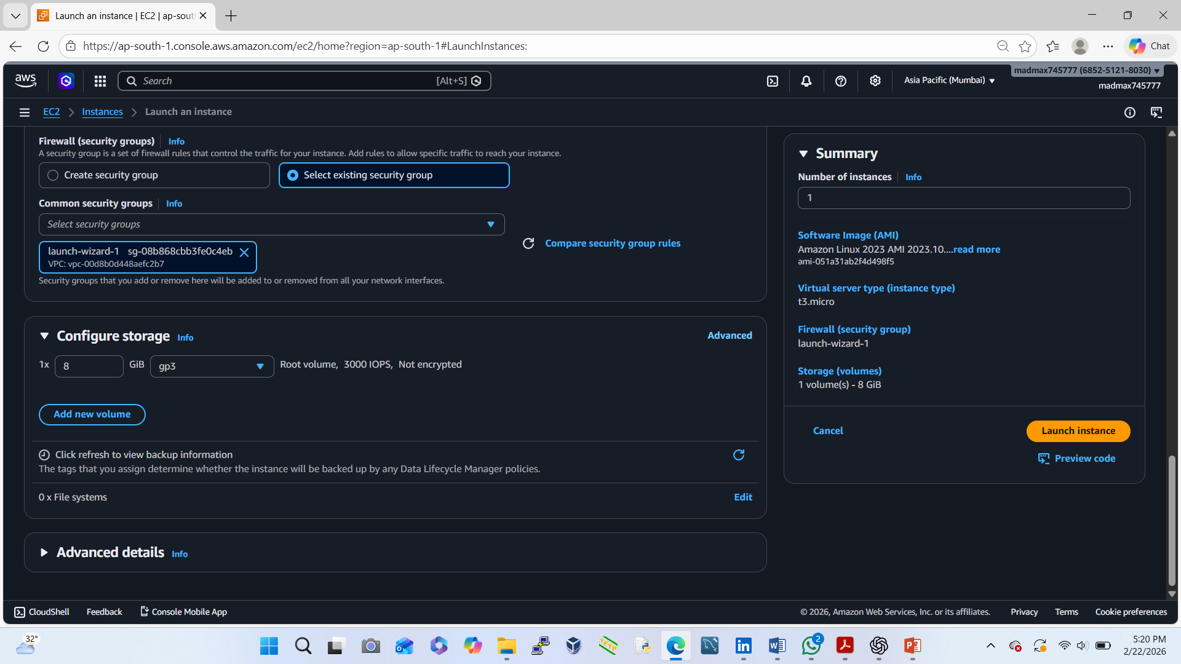
Launch EC2 in Region A (Primary Region)
Login to AWS Console
Switch region → ap-south-1
Go to EC2 → Launch Instance
Choose:
AMI: Amazon Linux 2
Instance type: t2.micro (Free Tier)
Create / select key pair
Security Group:
Allow SSH (22) – My IP
Allow HTTP (80) – Anywhere
Launch instance
🔹 Install a test application:

Slide 3
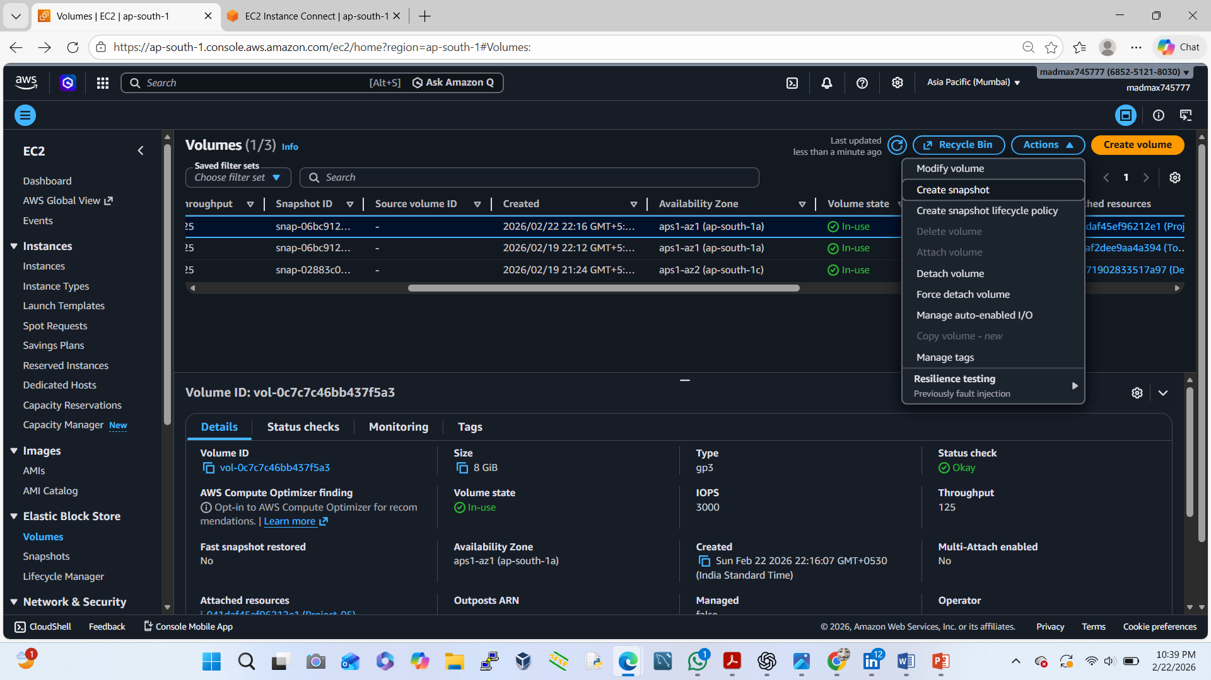
Create EBS Snapshot (Region A)
EC2 → Volumes
Select the root volume of our instance
Actions → Create Snapshot
Name: RegionA-Backup-Snapshot
Create snapshot
⏳ Wait until snapshot status = Completed

Slide 4
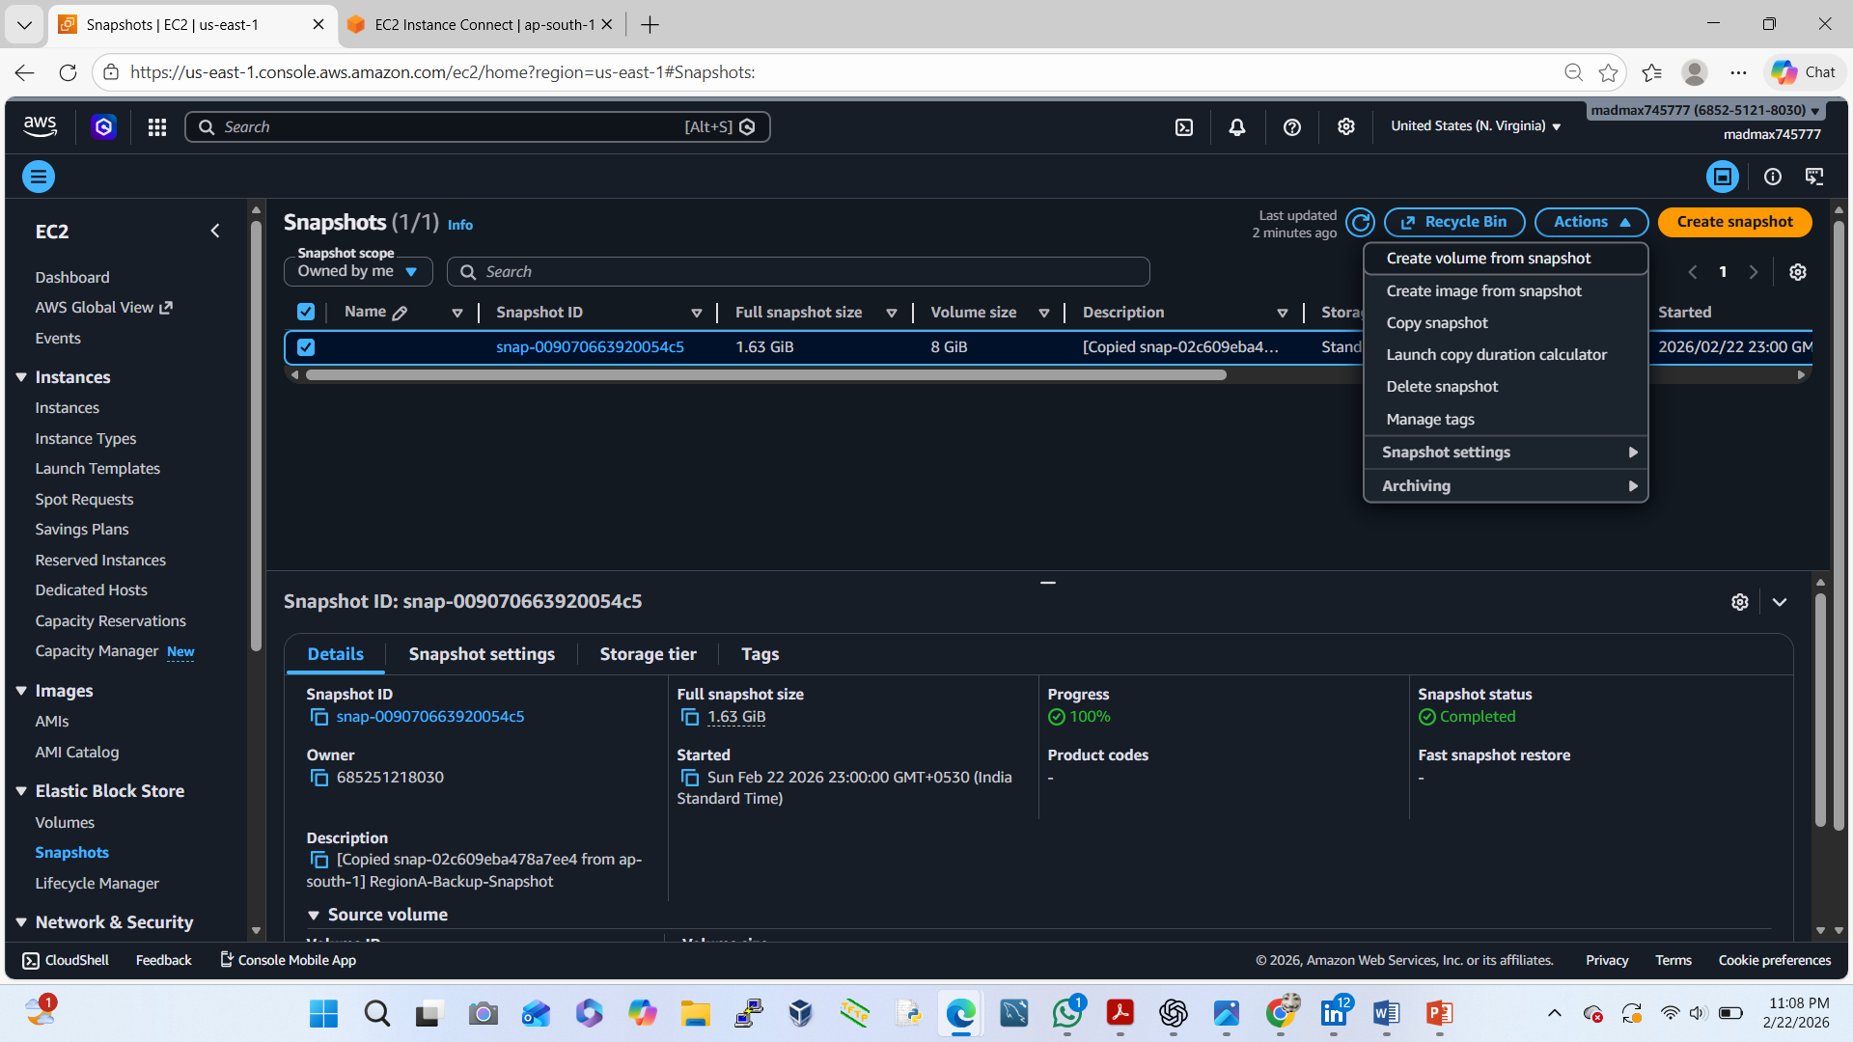
Copy Snapshot to Region B
EC2 → Snapshots
Select our snapshot
Actions → Copy Snapshot
Destination region → us-east-1
Name: RegionB-Copy-Snapshot
Copy snapshot

Slide 5
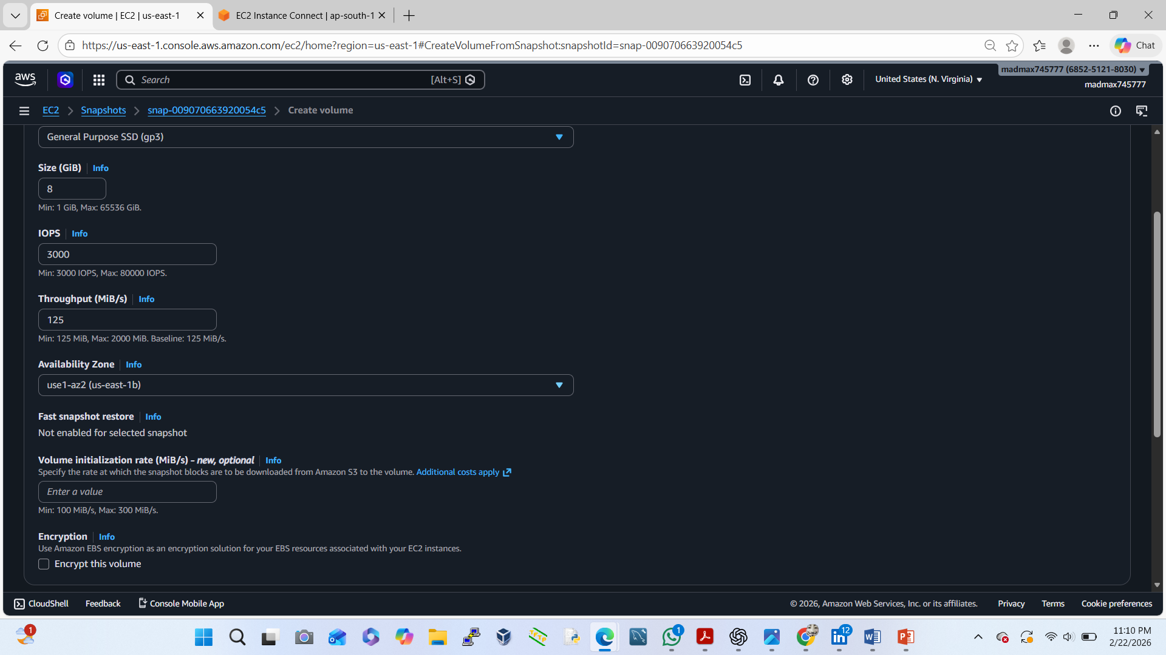
Restore EC2 in Region B
Switch region → us-east-1
EC2 → Snapshots
Select copied snapshot
Actions → Create Volume
AZ: choose any (same AZ you’ll launch EC2)
Create volume
Attach Volume to New EC2
Launch new EC2 instance (same AMI type)
EC2 → Volumes
Select created volume
Actions → Attach Volume
Attach to new EC2 instance

Slide 6
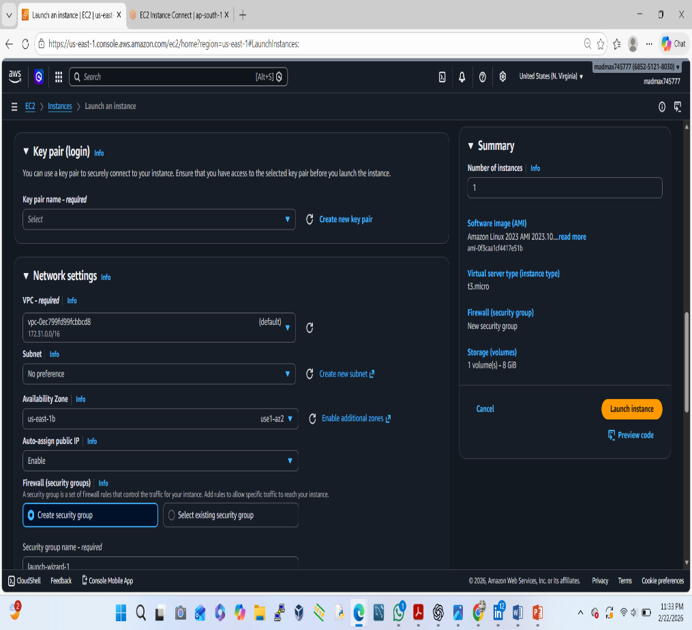
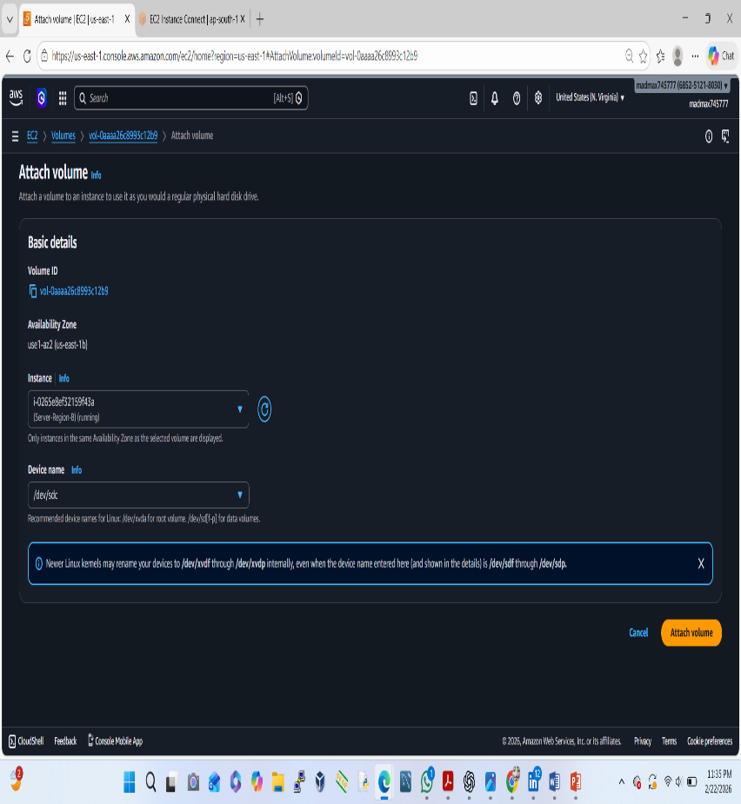
Attach Volume to New EC2
Launch new EC2 instance (same AMI type)
EC2 → Volumes
Select created volume
Actions → Attach Volume
Attach to new EC2 instance

Slide 7
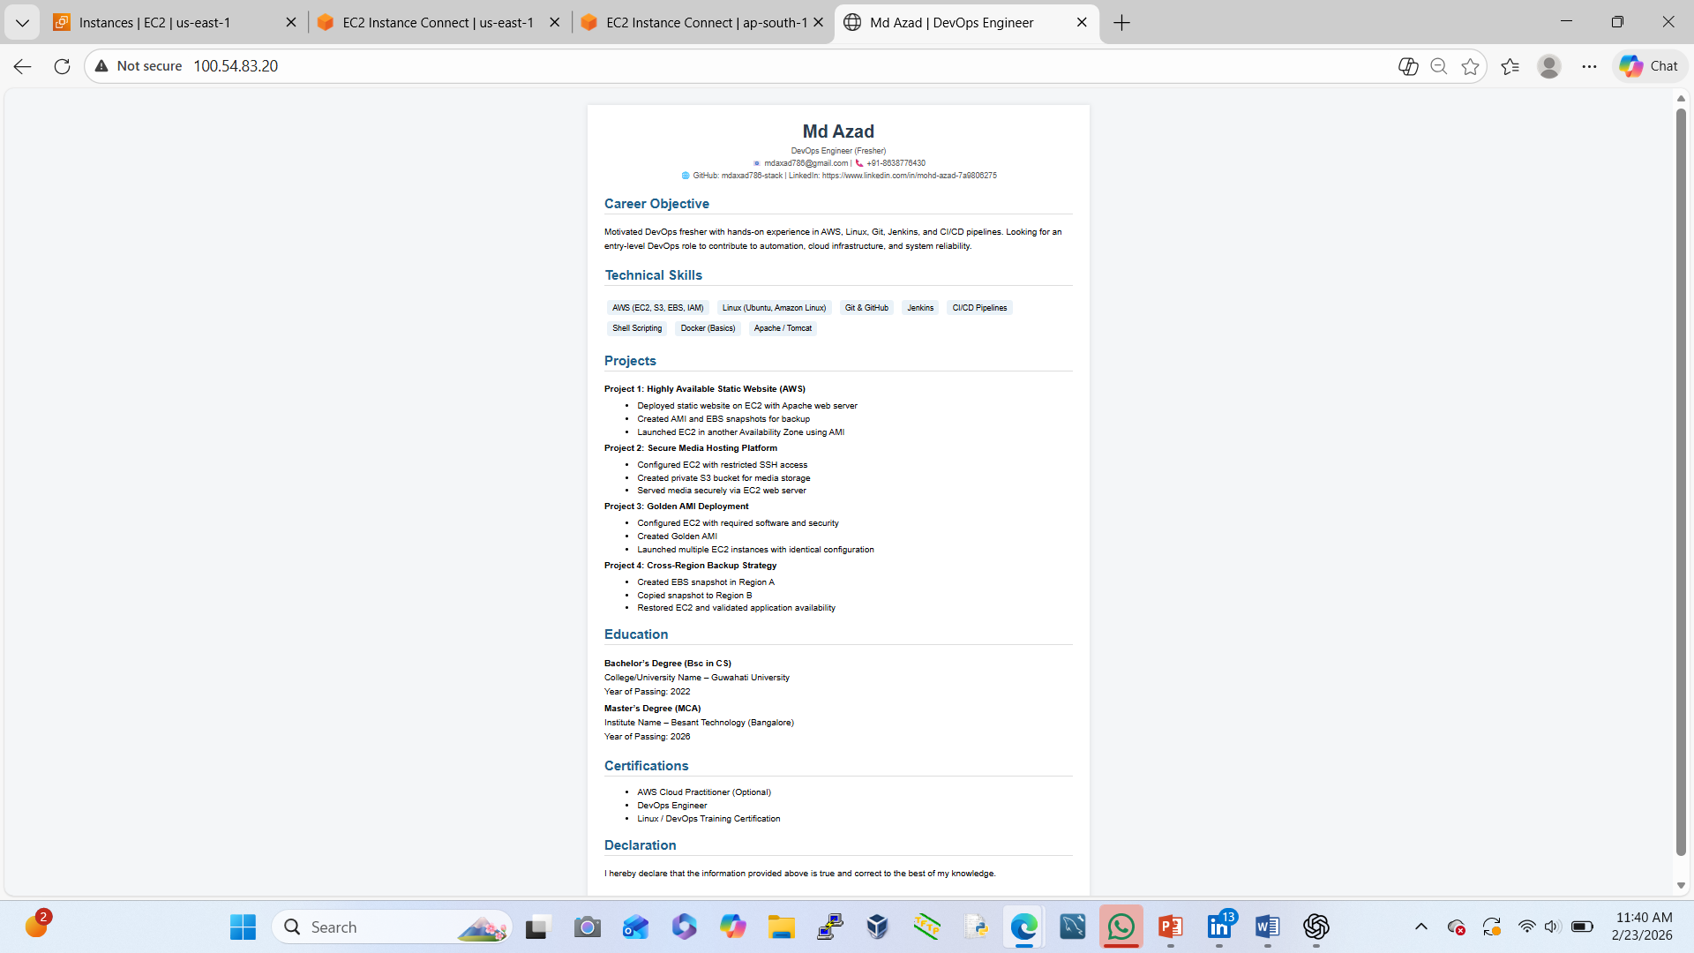
Validate Application Availability (Region B)
Open browser
Enter Public IP of Region B EC2
http://100.54.83.20
We should see:

